Slide 1
INAR 405
RESEARCH PAPER FORMAT & APA STYLE
ÇANKAYA UNIVERSITY

Slide 2
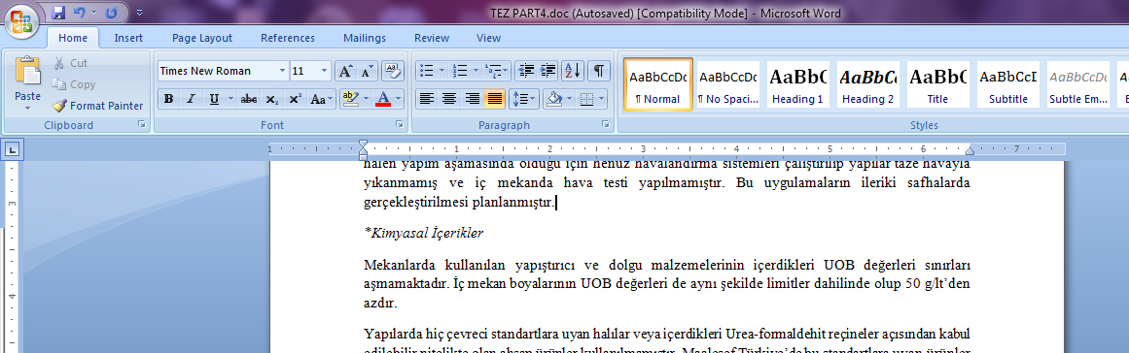
GENERAL FORMAT
1 ½ LINE SPACING
FONT: 12, TIMES NEW ROMAN
JUSTIFIED
MAXIMUM 30 PAGES (Including Tables & Figures)

Slide 3
GENERAL FORMAT
YOUR PAPER SHOULD CONSIST OF:
COVER PAGE
TABLE OF CONTENTS (Outline)
LIST OF TABLES
LIST OF FIGURES
MAIN BODY (Text)
REFERENCES
APPENDIX
                [On Separate Pages]
With the indication of related page numbers

Slide 4
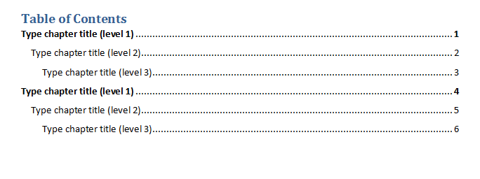
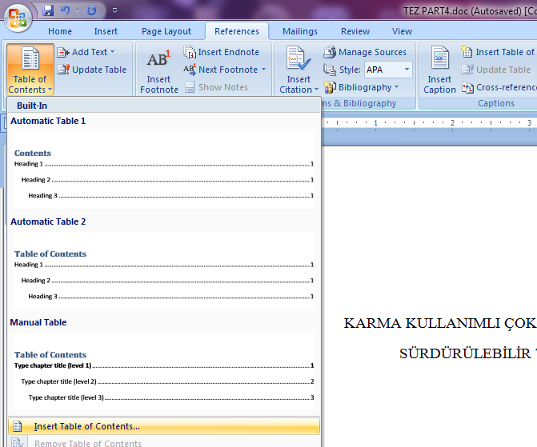
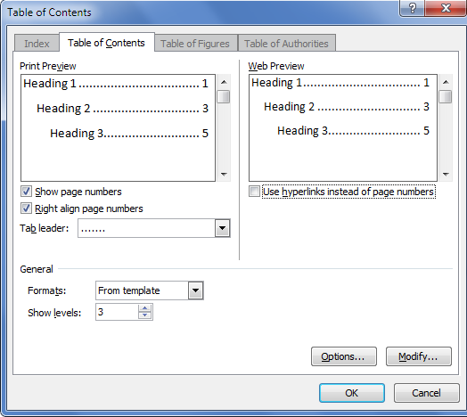
with page numbers

Slide 5
PAGE NUMBERING
MAIN BODY
INTRODUCTION
3
1, 2, 3, 4, 5, ...
LIST OF FIGURES
2
TABLE OF CONTENTS
1
COVER PAGE
iii
MAX. 30 PAGES
ii, iii, iv, v, ...
ii

Slide 6
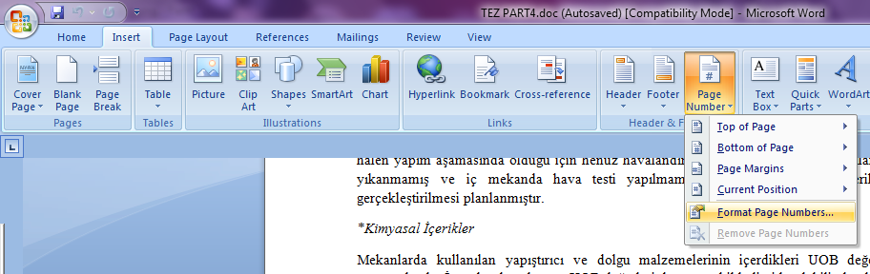
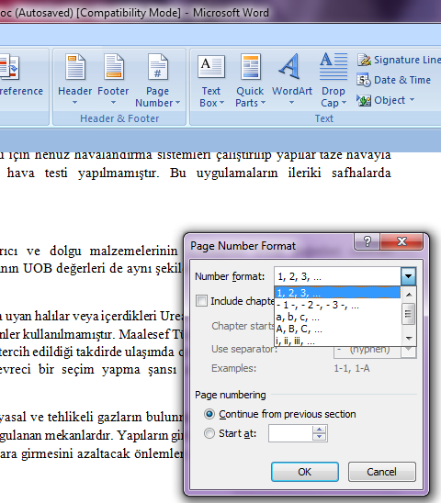
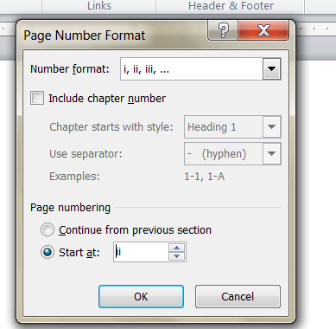
GENERAL FORMAT
PAGE NUMBERING:
From TABLE OF CONTENTS to MAIN BODY
  ii, iii, iv, v, ...
From MAIN BODY till the End
  1, 2, 3, 4, 5, ...

Slide 7
TABLE OF CONTENTS
  1. FIRST CHAPTER (INTRODUCTION) (level 1)
  1.1. Aim and Scope (level 2)
  1.2. Methodology (level 2)
  2. SECOND CHAPTER (level 1)
  2.1. Heading (level 2)
  2.1.1. Smaller Heading (level 3)
  2.1.2. Smaller Heading (level 3)
  2.1.2.1. Smallest Heading (level 4)
  2.1.2.2. Smallest Heading (level 4)
  2.2. Heading
  .
  .
  .

Slide 8
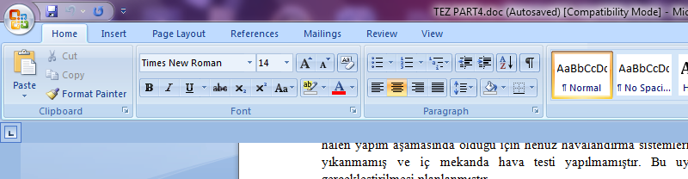
GENERAL FORMAT
HIERARCHY OF HEADINGS
  1. UPPERCASE, BOLD (level 1)
1.1. Lowercase, Bold (level 2)
1.1.1. Lowercase, Normal (level 3)
1.1.1.1. Lowercase, Italic (level 4)

Slide 9
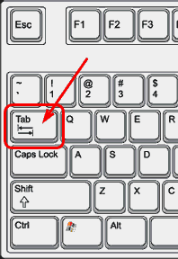
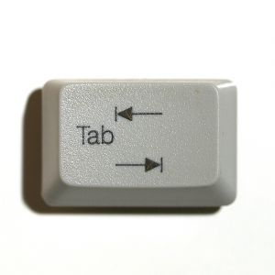
GENERAL FORMAT
HIERARCHY OF HEADINGS
1. UPPERCASE, BOLD
1.1. Lowercase, Bold
1.1.1. Lowercase, Normal
1.1.1.1. Lowercase, Italic
[Use the ‘TAB’ key for
Indents]

Slide 10
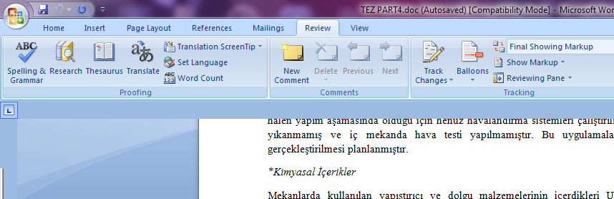
GENERAL FORMAT
SPELLING & GRAMMAR CHECK !
Microsoft Word → Under ‘REVIEW’ tab

Slide 11
GENERAL FORMAT
USE PASSIVE VOICE
e.g. NOT ‘I analyzed the building ...’ ✗
INSTEAD ‘The building was analyzed...’ ✓

Slide 12
GENERAL FORMAT
AVOID IRRELEVANT USE OF FIGURES AND INFORMATION
Continuity of Text!
GIVE THE DEFINITIONS OF THE TERMS YOU USE
RELATED FIGURES SHOULD BE FOLLOWING TEXT

Slide 13
GENERAL FORMAT
NUMBERING OF FIGURES * Below the Figure, Centered
1. ---------------------
.
.
2. ----------------------
2.1. ---------------
2.2. *FIRST FIGURE
2.3. ---------------
2.4. *SECOND FIGURE
3. ---------------------
3.1. ---------------
3.2. *THIRD FIGURE
Figure ___ . ___ .
Figure 2.1. View from Entrance (Source)
Figure 2.2. First Floor Plan (Source)
Figure 3.1. View from Garden
(Photograph taken by the author)
Number of Chapter
Number of Figure
(within the chapter)

Slide 14
GENERAL FORMAT
NUMBERING OF TABLES
Table 1, Table 2, ...
* Above the Table, Centered
Table 1. ----------------
Table 2. ----------------

Slide 15
APA STYLE
MLA _ Engineering
APA _ Social Sciences
(American Psychological Association)
Conferences, Universities, Journals may have their own formats
THERE ARE 2 WAYS OF USING INFORMATION
TAKEN FROM A SOURCE
DIRECT QUOTATION PARAPHRASING
* REFERENCING IN TEXT
~ % 30-40 // ~ % 60-70
QUOTATIONS, PARAPHRASING ORIGINAL, SELF IDEAS, OPINIONS, OBSERVATIONS

Slide 16
APA STYLE_REFERENCING IN TEXT
PARAPHRASING In Your OWN Words
  Author’s Last Name
  Year of Publication (e.g. On page 1)
  ________________ (Jones, 2000) .
  “Title”
  If it is too long _ “First Few Words From The Title”
  Year of Publication (e.g. On page 2)
  -First box-
  ________________ (“Green Buildings”, 2000) .
  “First Few Words From The Title”
  n.d. (e.g. On page 2)
  -Second box-
  ________________ (“Green Buildings”, n.d.) .
NO AUTHOR
WEB PAGES
NO AUTHOR, NO DATE

Slide 17
APA STYLE_REFERENCING IN TEXT
PARAPHRASING In Your OWN Words
  INTERVIEW, E-MAIL, LECTURE (SOURCE NOT IN LITERATURE)
  First Name’s Initial
  Surname
  ‘personal communication’
  Exact Date (Month Day, Year) (e.g. On page 2) -Third Box-
  NOT IN REFERENCE LIST, ONLY IN TEXT!
  In the lecture of R. Jones ___________________________________
  ______________________ (personal communication, November 18, 2000) .
PERSONAL COMMUNICATION

Slide 18
APA STYLE_REFERENCING IN TEXT
PARAPHRASING In Your OWN Words
  TITLES OF LONGER WORKS ITALIC
  (BOOKS)
  In the work The Big Green__________________________________
  Written in italic
  TITLES OF SHORTER WORKS QUOTATION MARKS ( “ )
  (JOURNAL)
  In the work “Journal of Green Buildings” ___________________

Slide 19
APA STYLE_REFERENCING IN TEXT
PARAPHRASING In Your OWN Words
  MULTIPLE AUTHORS
  2 AUTHORS
  BOTH LAST NAMES + ‘and’ (each time)
  _______________________________________ (Jones and Anderson, 2000) .
  3/4/5 AUTHORS
  * FIRST TIME _ ALL LAST NAMES
  In the work of Jones, Anderson and Brown (2000), ___________
  OR
  ________________________ (Jones, Anderson & Brown, 2000).
  * NEXT TIME _ ONLY FIRST AUTHOR’S LAST NAME + ‘ et al.’
  _________________________ (Jones et al., 2000).
in sentence ‘and’
in paranthesis ‘&’

Slide 20
APA STYLE_REFERENCING IN TEXT
DIRECT QUOTATIONS Taking Words / Sentences As They Are
SHORT QUOTATIONS
If it is shorter than 40 words:
Double Quotation Marks (“)
Author’s Last Name
Year of Publication
Page Number
[e.g. On page 3]
-First Box-
BLOCK / LONG QUOTATIONS
If it is longer than 40 words:
NO Quotation Marks
New Line
Indent
Page Number
Author’s Last Name
Year of Publication
Font Size & Line Spacing Change
[e.g. On page 3]
-Third Box-

Slide 21
APA STYLE_REFERENCING IN TEXT
DIRECT QUOTATIONS Taking Words / Sentences As They Are
SHORT QUOTATIONS
“__________________________
______” (Jones, 2000, p.3).
No Author, No Date:
“__________________________
______” (“Title”, n.d., p.3).
No Page:
“__________________________
______” (Jones, 2000, n.p.).
More Than 1 Page:
“__________________________
______” (Jones, 2000, pp. 13-14).
BLOCK / LONG QUOTATIONS
__________________________
__________________________
__________________________
as Jones (2000) states:
____________________
____________________
______________(p.13).
Block Quotation

Slide 22
APA STYLE_REFERENCING IN TEXT
DIRECT QUOTATIONS Taking Words / Sentences As They Are
SHORT QUOTATIONS
“__________________________
______” (Jones, 2000, p.3).
No Author, No Date:
“__________________________
______” (“Title”, n.d., p.3).
No Page:
“__________________________
______” (Jones, 2000, n.p.).
More Than 1 Page:
“__________________________
______” (Jones, 2000, pp. 13-14).
BLOCK / LONG QUOTATIONS
__________________________
__________________________
__________________________
as Jones (2000) states:
_____________________
_____________________
_______________(p.13).
Block Quotation

Slide 23
APA STYLE_REFERENCE LIST
0
SOURCE CITED IN TEXT
REFERENCE LIST
REFERENCES
ENTRY IN
REFERENCE LIST
CITED IN TEXT
INTRODUCTION
LIST OF FIGURES
TABLE OF CONTENTS
COVER PAGE
Personal communications DO NOT appear in the reference list!
CENTERED

Slide 24
APA STYLE_REFERENCE LIST
SOURCES
PRINTS
ELECTRONIC SOURCES
Webpages
Non-periodicals
Longer works
(Books)
Shorter works
(Proceedings, Essays)
Periodicals
(Journal, Newspaper,
Magazine)

Slide 25
APA STYLE_REFERENCE LIST
PRINTS:
Non-Periodicals:
Long Sources (Books)
Author, A.A. (Year of publication). Title of the work : Capital letter also for subtitle. Location : Publisher.
Example:
Chambers, N. (2013). Sharing nature's interest: Ecological footprints as an indicator of sustainability. New York : Routledge.
Last Name, Initial.
Author: Nicky Chambers → Chambers, N.
italic
Title of the non-periodicals: Only the initial of the FIRST word is in CAPITALS

Slide 26
APA STYLE_REFERENCE LIST
PRINTS:
Periodicals:
An Artical In A Periodical:
Author, A.A. (Year). Title of article. Title of Periodical, volume number (issue), pages.
Example:
Smith, E. (2014). Service credit union headquarters case study. Journal of Green Building, 9 (1), 23-39.
Title of the periodicals: Initial of ALL words are in CAPITALS

Slide 27
APA STYLE_REFERENCE LIST
ELECTRONIC SOURCES:
Author, A. A. (Year). Title of document. Retrieved Month Day, Year from http://Web address
Angeli, E. (2009). General format. Retrieved May 5, 2010 from http://owl.english.purdue.edu/owl/resource/560/01/

Slide 28
APA STYLE_REFERENCE LIST
AUTHOR/ AUTHORS
Two to Six Authors:
Kernis, M. H., Cornell, D. P., Sun, C. R., Harlow, T., & Bach, J. S. (1993). There's more to self-esteem than whether it is high or low: The importance of stability of self-esteem. Journal of Personality and Social Psychology, 65, 1190-1204.
More Than SixAuthors
Miller, F. H., Choi, M. J., Angeli, L. L., Harland, A. A., Stamos, J. A., Thomas, S. T., et al. (2009). Web site usability for the blind and low-vision user. Technical Communication, 57, 323-335.

Slide 29
APA STYLE_REFERENCE LIST
If no author is given for a particular source
Example:
("There is more to", 1993). In Text
There is more to self-esteem than whether it is high or low: The importance of stability of self-esteem. (1993). Journal of Personality and Social Psychology, 65, 1190-1204.

Slide 30
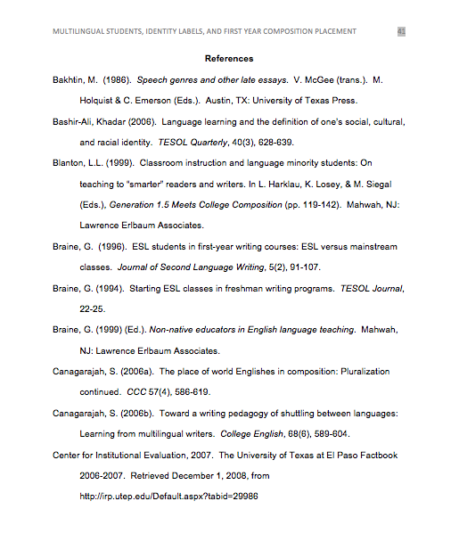
APA STYLE_REFERENCE LIST
IN ALPHABETICAL ORDER!

Slide 31
APA STYLE_REFERENCE LIST
IN ALPHABETICAL ORDER!
INDENTS AFTER FIRST LINE!

